Slide 1


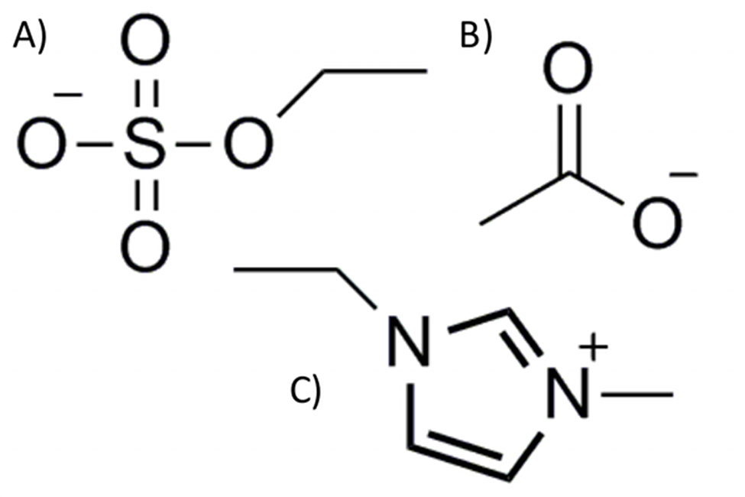
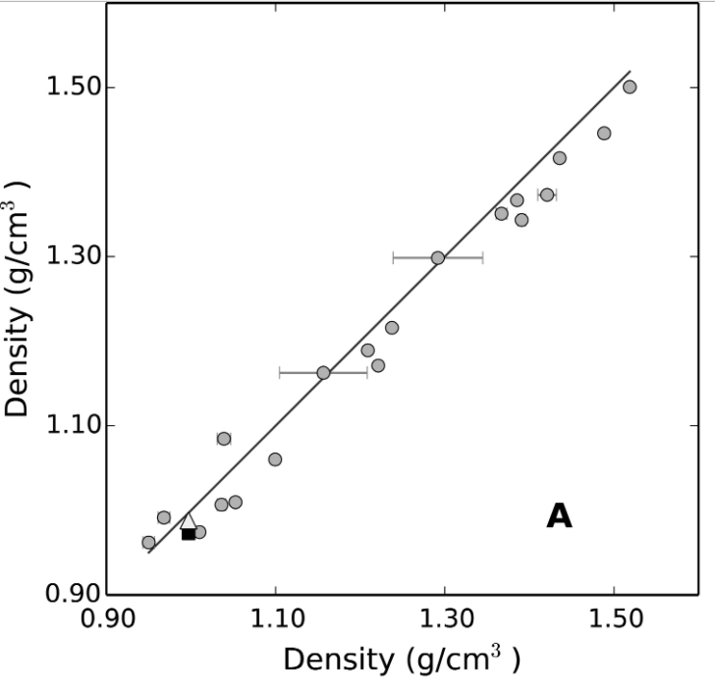
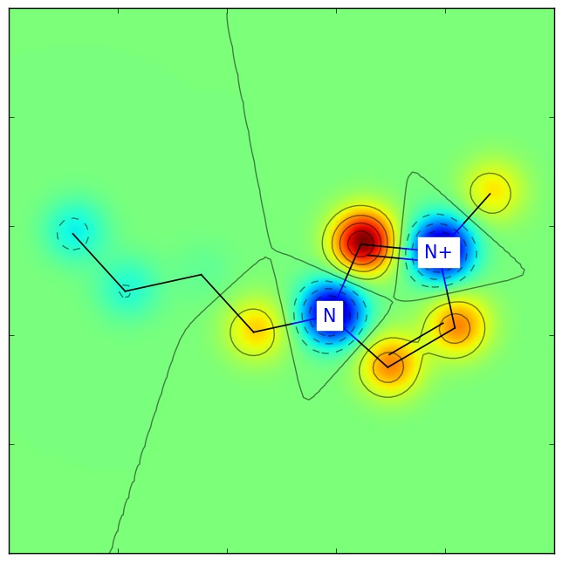
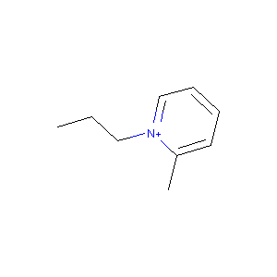
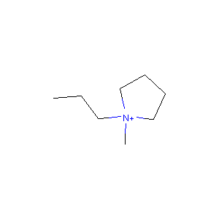
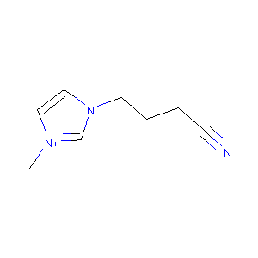
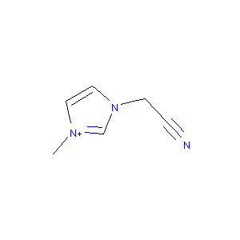
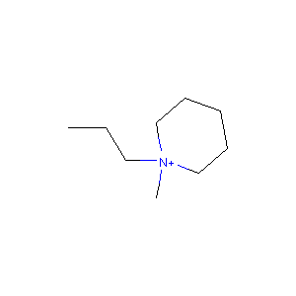
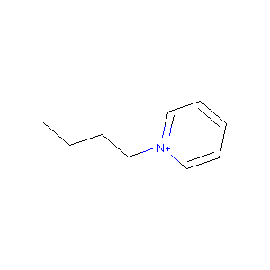
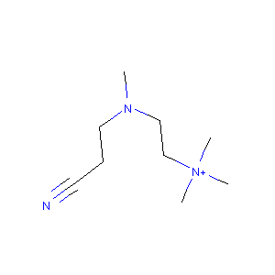
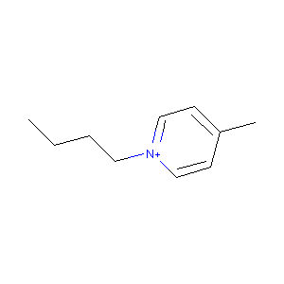
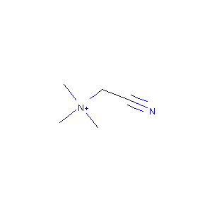
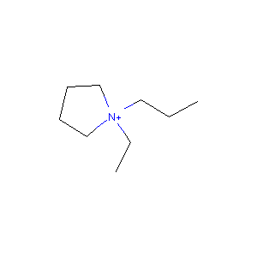
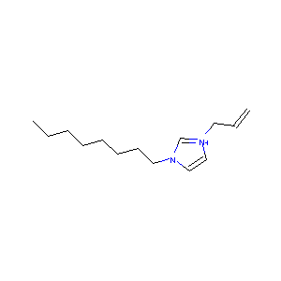
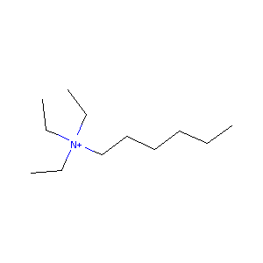
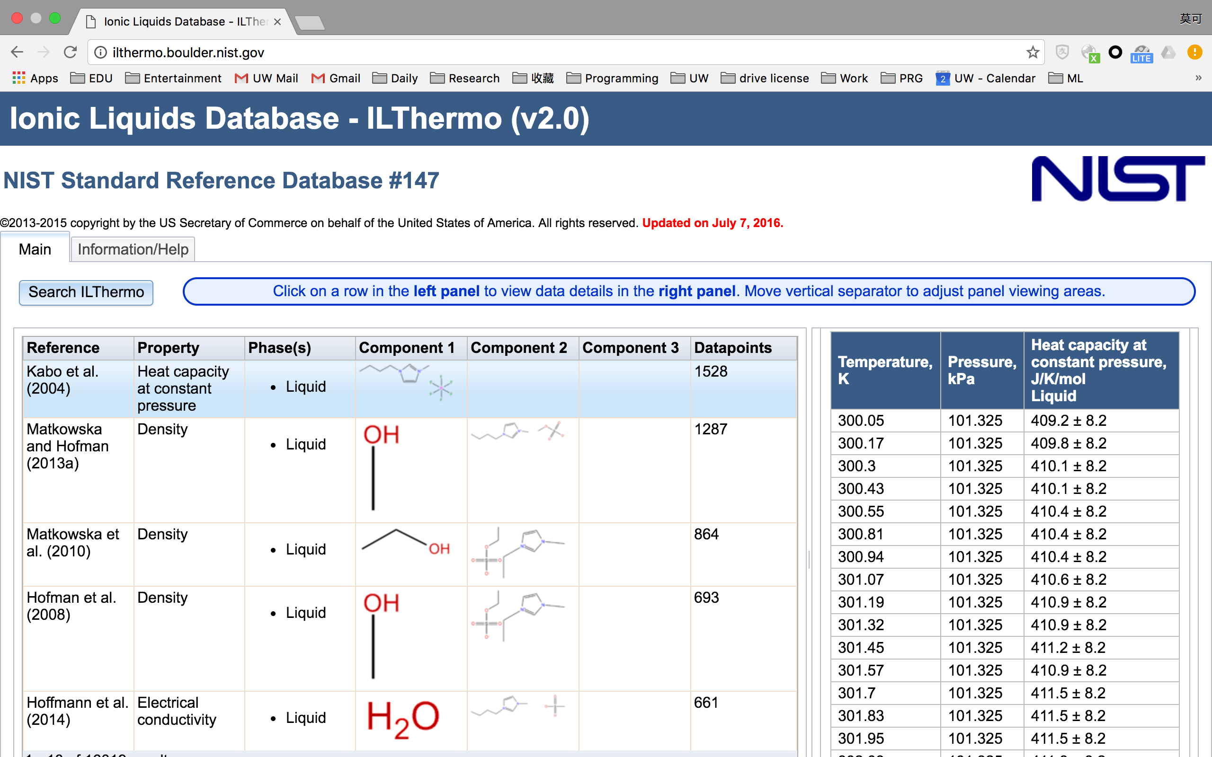
Quantitative Structure Property Relationship of Ionic Liquid
Moke Mao
Department of Materials Science and Engineering
University of Washington, Seattle, WA
Background
http://www.rdki.orgdocs/_
Regression
http://www.rdki.orgdocs/_
K-means Clustering
Ionic liquids (ILs) are organic salts that have melting points below 100°C. As solvents, they displays a number of unique properties that are not found in any conventional solvents, such as negligible vapor pressure, high temperature stability, large electrochemical stability window and very large design space, which make IL a promising alternative for battery electrolyte.
CATION steiger
CATION Marsili Partial Charges
CATION BertzCT
CATION Ipc
CATION EState_VSA7
CATION Topliss fragments
ANION steiger
ANION Marsili Partial Charges
ANION MolWt
ANION HeavyAtomMolWt
ANION TPSA
ANION PEOE_VSA10
ANION SMR_VSA1
ANION EState_VSA9
ANION VSA_EState8
Pressure
26 cations were clustered to 3~5 clusters by K-means. Figures on the left is a typical clustering:
Cations from same family are assigned to same cluster
Cations from different family but share same functional groups are assigned to same cluster
Potentially, K-means could be used to find “neighbor” ions with similar properties.
(A)Ethyl Sulfate (B) Acetate
(C) 1-ethyl-3-methylimidazolium
A
B
Quantitative structure property relationship is a cheminformatic tool used in computer-aided molecular design. It links changes at molecular structure level to macroscopic properties. QSPR differs from other areas of computational methods that base on physics law, such as quantum calculation or molecular dynamic simulations. Machine learning is one of the methods in QSPR.
Density of multiple ionic liquid predicted by
(A) LASSO (B) molecular dynamic simulation vs experiment data
Density can be well predicted with linear model, with a comparable accuracy with molecular dynamic simulation (GAFF). But in the sense of efficiency, it takes 10h to simulate one date point in plot B, but only one second with all the data in plot A.
16 descriptors are selected from 190 features when a large regularization is applied in LASSO. These descriptors can be considered as most contributing features of molecular structure for density.
Visualization of Gasteiger partial charges of [BMIM]⁺
Each of descriptors can be visualized and analyzed in RDkit, which gives an insight of “favorable” molecular structure.
New IL ions with ideal property can be ”designed” by customize these contributing features.
Pyridinium , Piperidinium and Pyrrolidinium
Tetraalkylammonium and some other cations with triple bonds
Data Source
16 quantitative descriptors selected by LASSO
Conclusions
Density of ILs can be well predicted by linear model and cheminformatics descriptors.
Contributing descriptors for density and viscosity are identified in LASSO regression.
Viscosity is better fitted with non-linear model. However, due to the data scale, both SVR and Neural Network are over-fitted.
Viscosity of IL from an unknown category is very hard to predict.
Compounds with different functional groups and topology can be classified by K-means.
Machine learning can be an effective tool in understanding the QSPR of IL, and a good guidance in computer aided molecular design .
LASSO
SVR
By sklearn
Neural Network
Training data set and test data set are randomly separated. Training data covered cations from all categories
All the data are obtained from ILThermo (http://ilthermo.boulder.nist.gov), a web-based ionic liquids database available free to the public. Up to today, It has recorded multiple thermal properties of 1461 kinds of ionic liquid with more than 40K data points extracted from 2452 paper. Data in ILThermo are well organized and archived with detailed description of key elements in experimental investigation such as sample purification and measurement methods. The disadvantage of this data set is that it does not provide a downloadable file.
Future Work
Build a pipeline from ILthermo database, through SMILES notation generation, Rdkit descriptors generation, to machine learning and make an automatic package.
Collect more experiment data with ions from other family.
Adjust parameter for non-linear model for better fitting.
Design new IL by screening IL pool or genetic algorithm.
RDKit is an open source cheminformatics toolkit for python. It reads molecule structure from string form notations such as SMILES/SMARTS, or structure file like PDB, and generates encoded descriptors/finger prints of the molecule. These descriptors/finger prints are the quantitative features that represents topological, structural, quantum mechanical and constitutional information of the molecule. Rdkit is also powerful on visualizing molecular structure and descriptors.
Training data set and test data set are separated by IL category. All the IL categories in test set has not been trained.
Reference
Data from this project is manually selected from ILthermo data base; SMILES notations are obtained from PubChem database; SMILES strings and experiment data are fed into RDkit to generate the data set for machine learning:
Data covered 10 species of cations and 24 species of anions.
510 data points for IL density, with 408 training data and 102 test data.
499 data points for IL viscosity, with 399 training data and 100 test data.
Each data points is an experiment data point for a pair of cation and anion. It consists of 190 feature and 1 target. Features are pressure, temperature and 94 descriptors for both cation and anion. Target is the experiment measured value of viscosity or density.
[1]Kazakov, A.; Magee, J.W.; Chirico, R.D.; Paulechka, E.; Diky, V.; Muzny, C.D.; Kroenlein, K.; Frenkel, M. "NIST Standard Reference Database 147: NIST Ionic Liquids Database - (ILThermo)", Version 2.0, National Institute of Standards and Technology, Gaithersburg MD, 20899, http://ilthermo.boulder.nist.gov.
[2]Dong, Q.; Muzny, C.D.; Kazakov, A.; Diky, V.; Magee, J.W.; Widegren, J.A.; Chirico, R.D.; Marsh, K.N.; Frenkel, M., "ILThermo: A Free-Access Web Database for Thermodynamic Properties of Ionic Liquids." J. Chem. Eng. Data, 2007, 52(4), 1151-1159, doi: 10.1021/je700171f.
[3] Billard, I., et al. "In silico design of new ionic liquids based on quantitative structure− property relationship models of ionic liquid viscosity." The Journal of Physical Chemistry B 115.1 (2010): 93-98.
[4] Sprenger, K. G., Vance W. Jaeger, and Jim Pfaendtner. "The General AMBER Force Field (GAFF) Can Accurately Predict Thermodynamic and Transport Properties of Many Ionic Liquids." The Journal of Physical Chemistry B 119.18 (2015): 5882-5895.
Regularization = 2
Iteration number = 1000
C=1.0, cache_size=200,
coef0=0.0, degree=3, epsilon=0.2, gamma='auto', kernel='rbf’
Hidden layer =1
Hidden layer nodes = 300
Minibatch = 3
Epoch = 2000
Learning rate = 5e-6
Parameters

